Slide 1












Slide 2
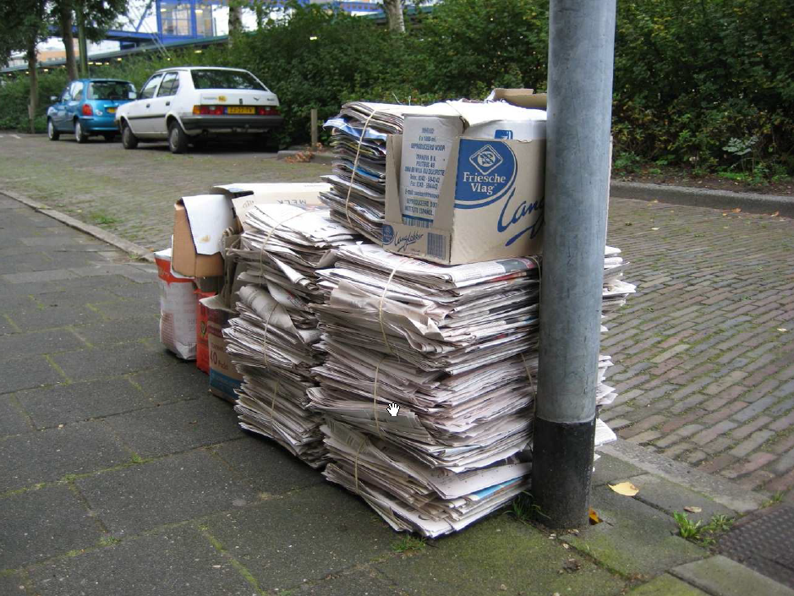
Documentation
Write once … and never look at after

Slide 3

Documentation
Usefull for users / Boring to write

Slide 4

Documentation
Hard to keep it up-to-dated

Slide 5
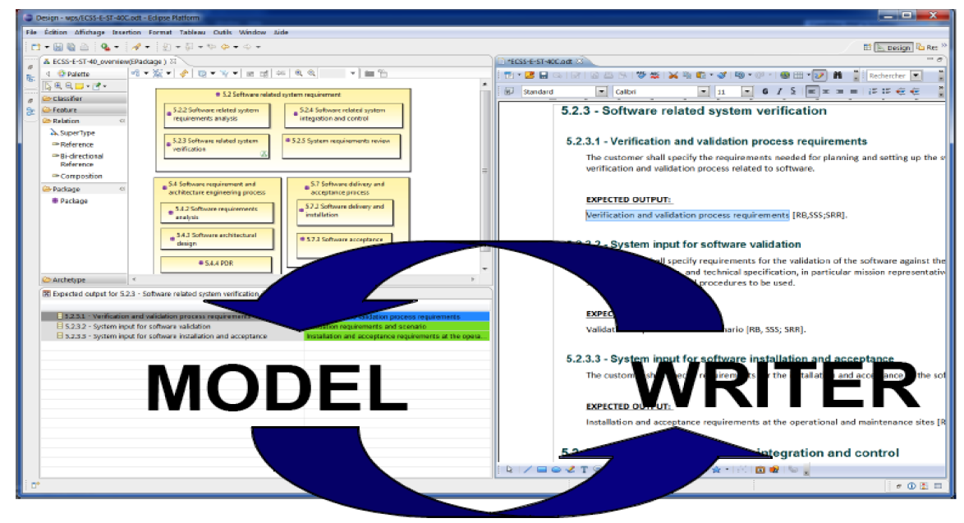

Slide 6
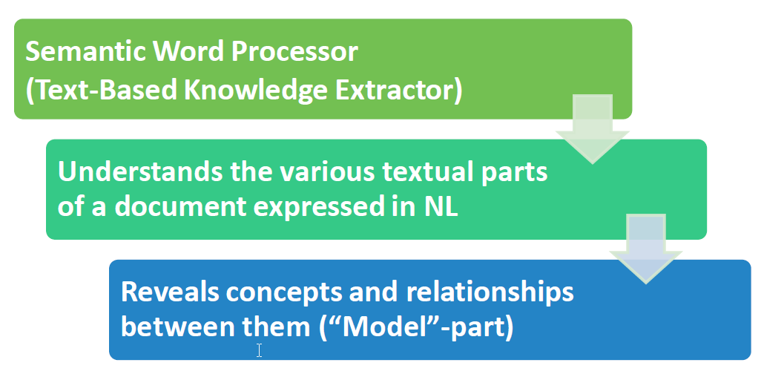

Slide 7
Use case

Slide 8

ModelWriter Architecture
Editor
Documents
(doc, docx, odt,textile,etc)
Texts
Connectors
Text
Semantic
Module
KB
Model
Models Connectors
Model Integration
Module
Model
Models

Slide 9
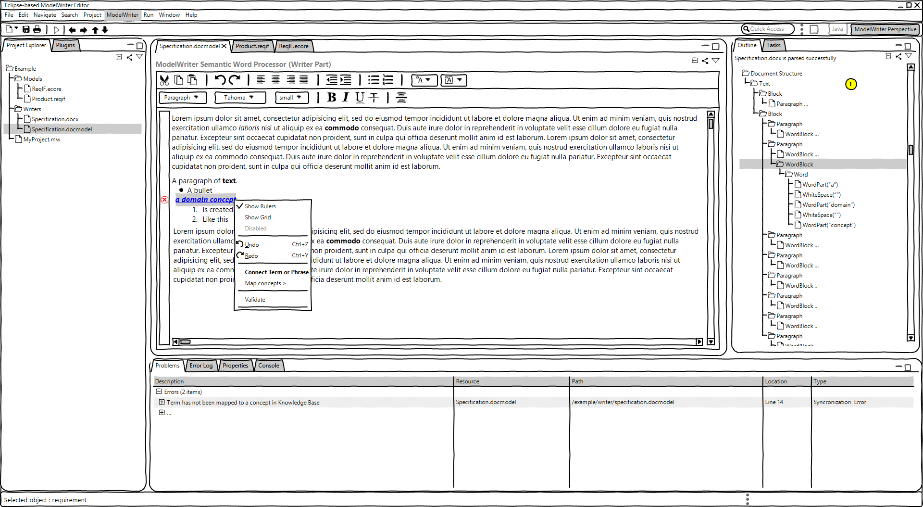
UI Sketcher

Slide 10
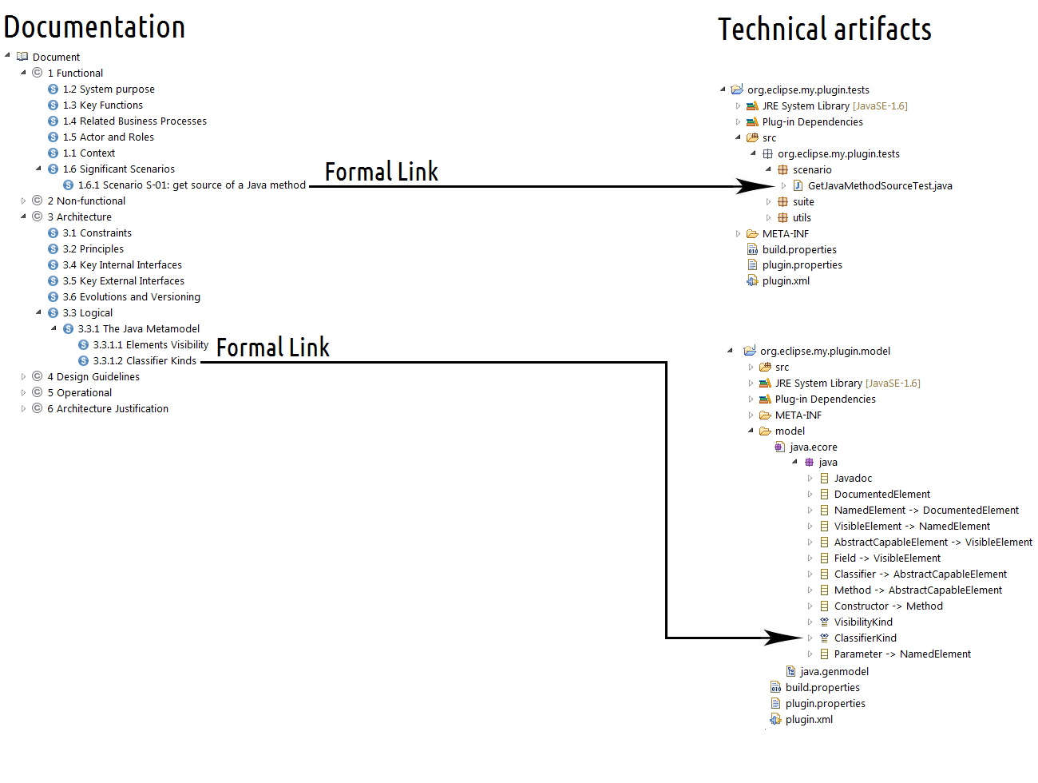

Mylyn Intent – Open Source project – Ex with Java

Slide 11
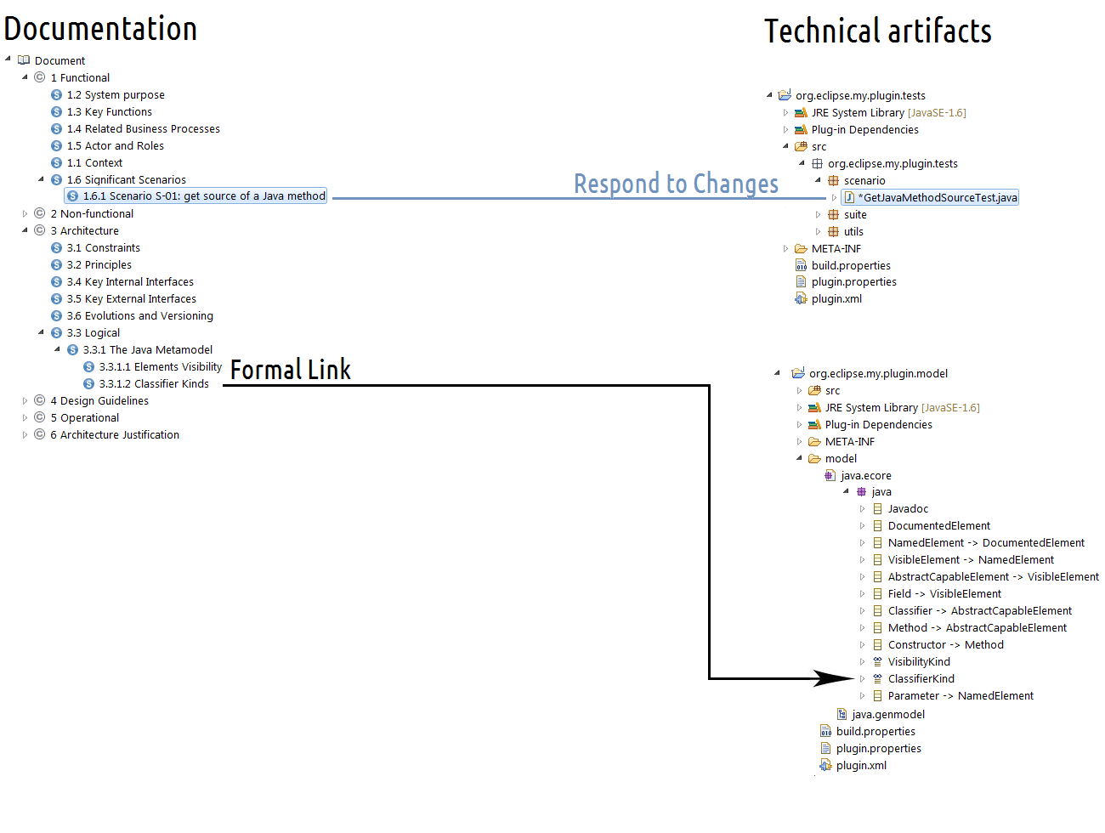
Mylyn Intent - 1st experimentation

Slide 12

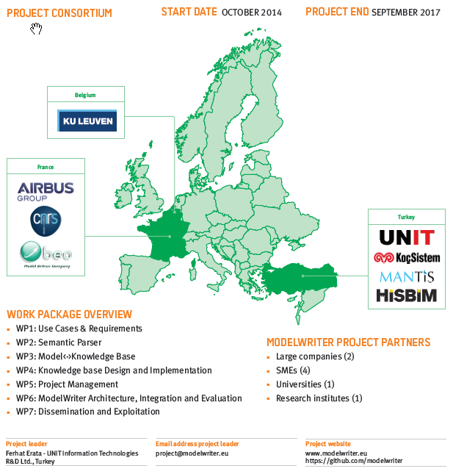

Slide 13
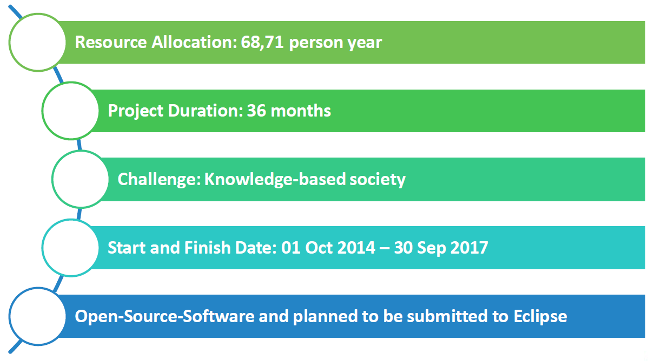
ModelWriter – overview and roadmap

Slide 14

Semantic Parser
Find semantic with ontologies

Slide 15

Semantic Parser
Keep the consistency across several vocabularies

Slide 16

Manage the (de)synchronization

Slide 17

Thank you

